Slide 1
Non Linear Data Structure:
Tree Data Structure
A tree is a nonlinear hierarchical data structure that consists of nodes connected by edges.
A tree data structure is a hierarchical structure that is used to represent and organize data in a way that is easy to navigate and search.
It is a collection of nodes that are connected by edges and has a hierarchical relationship between the nodes.
The topmost node of the tree is called the root, and the nodes below it are called the child nodes.
Each node can have multiple child nodes, and these child nodes can also have their own child nodes, forming a recursive structure.

Slide 2
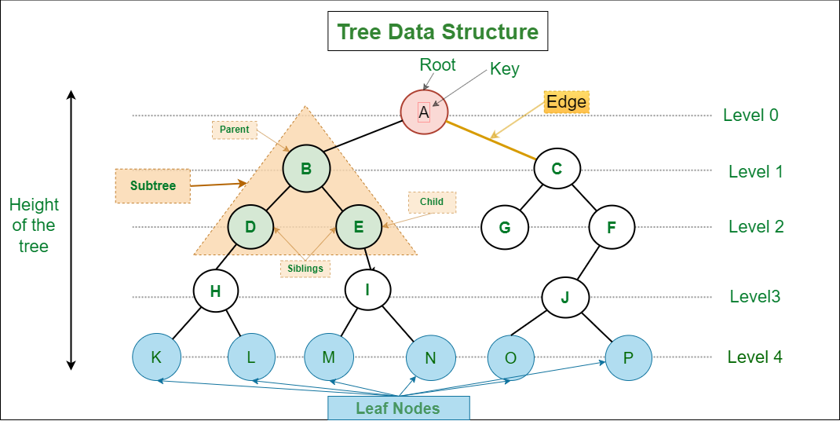

Slide 3
A tree consists of a root, and zero or more subtrees T₁, T₂, … , T_{k} such that there is an edge from the root of the tree to the root of each subtree.
Why Tree Data Structure?
Other data structures such as arrays, linked list, stack and queue are linear data structures that store data sequentially.
In order to perform any operation in a linear data structure, the time complexity increases with the increase in the data size.
But, it is not acceptable in today's computational world.
Different tree data structures allow quicker and easier access to the data as it is a non-linear data structure.

Slide 4
Tree Terminologies
Node
A node is an entity that contains a key or value and pointers to its child nodes.
The last nodes of each path are called leaf nodes or external nodes that do not contain a link/pointer to child nodes.
The node having at least a child node is called an internal node.
Edge
It is the link between any two nodes.
Root
It is the topmost node of a tree.
Height of a Node
The height of a node is the number of edges from the node to the deepest leaf (ie. the longest path from the node to a leaf node).
Depth of a Node
The depth of a node is the number of edges from the root to the node.

Slide 5
Height of a Tree
The height of a Tree is the height of the root node or the depth of the deepest node.
Degree of a Node
The degree of a node is the total number of branches of that node.
Forest
A collection of disjoint trees is called a forest.
Parent Node:
The node which is a predecessor of a node is called the parent node of that node. {B} is the parent node of {D, E}.
Child Node:
The node which is the immediate successor of a node is called the child node of that node. Examples: {D, E} are the child nodes of {B}.

Slide 6
Root Node:
The topmost node of a tree or the node which does not have any parent node is called the root node.
{A} is the root node of the tree.
A non-empty tree must contain exactly one root node and exactly one path from the root to all other nodes of the tree.
Leaf Node or External Node:
The nodes which do not have any child nodes are called leaf nodes. {K, L, M, N, O, P} are the leaf nodes of the tree.
Ancestor of a Node:
Any predecessor nodes on the path of the root to that node are called Ancestors of that node.
{A,B} are the ancestor nodes of the node {E}

Slide 7
Descendant:
Any successor node on the path from the leaf node to that node.
{E,I} are the descendants of the node {B}.
Sibling:
Children of the same parent node are called siblings.
{D,E} are called siblings.
Level of a node:
The count of edges on the path from the root node to that node.
The root node has level 0.
Internal node: A node with at least one child is called Internal Node.
Neighbors of a Node: Parent or child nodes of that node are called neighbors of that node.
Subtree: Any node of the tree along with its descendant.

Slide 8
Properties of a Tree:
Number of edges:
An edge can be defined as the connection between two nodes. If a tree has N nodes then it will have (N-1) edges.
There is only one path from each node to any other node of the tree.
Depth of a node:
The depth of a node is defined as the length of the path from the root to that node.
Each edge adds 1 unit of length to the path.
So, it can also be defined as the number of edges in the path from the root of the tree to the node.

Slide 9
Height of a node:
The height of a node can be defined as the length of the longest path from the node to a leaf node of the tree.
Height of the Tree:
The height of a tree is the length of the longest path from the root of the tree to a leaf node of the tree.
Degree of a Node:
The total count of subtrees attached to that node is called the degree of the node.
The degree of a leaf node must be 0.
The degree of a tree is the maximum degree of a node among all the nodes in the tree.

Slide 10
Why to use Tree Data Structure?
1. One reason to use trees might be because you want to store information that naturally forms a hierarchy.
For example, the file system on a computer.
2. Trees (with some ordering e.g., BST) provide moderate access/search (quicker than Linked List and slower than arrays). 3. Trees provide moderate insertion/deletion (quicker than Arrays and slower than Unordered Linked Lists). 4. Like Linked Lists and unlike Arrays, Trees don’t have an upper limit on the number of nodes as nodes are linked using pointers.

Slide 11
Types of Tree
The different types of tree data structures are as follows:
1. General tree
A general tree data structure has no restriction on the number of nodes.
It means that a parent node can have any number of child nodes.
2. Binary tree
A node of a binary tree can have a maximum of two child nodes.
In the given tree diagram, node B, D, and F are left children, while E, C, and G are the right children.
3. Balanced tree
If the height of the left sub-tree and the right sub-tree is equal or differs at most by 1, the tree is known as a balanced tree.

Slide 12
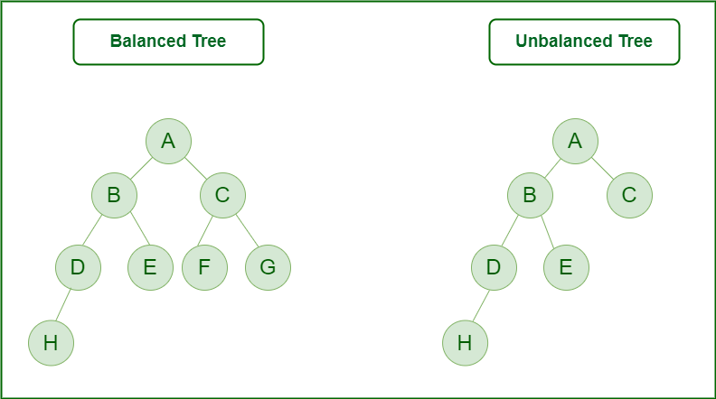

Slide 13
4. Binary search tree
As the name implies, binary search trees are used for various searching and sorting algorithms.
The examples include AVL tree and red-black tree.
It is a non-linear data structure.
It shows that the value of the left node is less than its parent, while the value of the right node is greater than its parent.
5. AVL Tree
AVL tree is a self-balancing binary search tree in which each node maintains extra information called a balance factor whose value is either -1, 0 or +1.
AVL tree got its name after its inventor Georgy Adelson-Velsky and Landis.

Slide 14
Balance Factor
Balance factor of a node in an AVL tree is the difference between the height of the left subtree and that of the right subtree of that node.
Balance Factor = (Height of Left Subtree - Height of Right Subtree) or (Height of Right Subtree - Height of Left Subtree)
The self balancing property of an avl tree is maintained by the balance factor.
The value of balance factor should always be -1, 0 or +1.

Slide 15
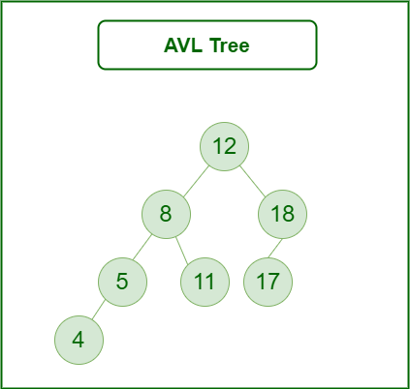

Slide 16
Applications of AVL Tree:
It is used to index huge records in a database and also to efficiently search in that.
For all types of in-memory collections, including sets and dictionaries, AVL Trees are used.
Database applications, where insertions and deletions are less common but frequent data lookups are necessary
Software that needs optimized search.
It is applied in corporate areas and storyline games.

Slide 17
Advantages of AVL Tree:
AVL trees can self-balance themselves.
It is surely not skewed.
It provides faster lookups than Red-Black Trees
Better searching time complexity compared to other trees like binary tree.
Height cannot exceed log(N), where, N is the total number of nodes in the tree.

Slide 18
Disadvantages of AVL Tree:
It is difficult to implement.
It has high constant factors for some of the operations.
Less used compared to Red-Black trees.
Due to its rather strict balance, AVL trees provide complicated insertion and removal operations as more rotations are performed.
Take more processing for balancing.

Slide 19
6. B-tree
B-tree is a special type of self-balancing search tree in which each node can contain more than one key and can have more than two children.
It is a generalized form of the binary search tree.
It is also known as a height-balanced m-way tree.
Why do you need a B-tree data structure?
The need for B-tree arose with the rise in the need for lesser time in accessing physical storage media like a hard disk. The secondary storage devices are slower with a larger capacity. There was a need for such types of data structures that minimize the disk access.
Other data structures such as a binary search tree, avl tree, red-black tree, etc can store only one key in one node. If you have to store a large number of keys, then the height of such trees becomes very large, and the access time increases.
However, B-tree can store many keys in a single node and can have multiple child nodes. This decreases the height significantly allowing faster disk accesses.

Slide 20
B-tree Properties
For each node x, the keys are stored in increasing order.
In each node, there is a boolean value x.leaf which is true if x is a leaf.
If n is the order of the tree, each internal node can contain at most n - 1 keys along with a pointer to each child.
Each node except root can have at most n children and at least n/2 children.
All leaves have the same depth (i.e. height-h of the tree).
The root has at least 2 children and contains a minimum of 1 key.

Slide 21
Advantages of Tree data structure
Efficient insertion, deletion, and search operations.
Trees are flexibility in terms of the types of data that can be stored.
It is used to represent hierarchical relationships.
It has the ability to represent a recursive structure.
Used in various algorithms and data structures such as Huffman coding and decision trees.
Trees use less space than other data structures, like lists, and linked lists.
Trees are dynamic in nature.
Tree data structures can automatically self-organize as new data is added or removed, which can improve performance and reduce complexity.

Slide 22
Disadvantages of Tree data structure
Trees require additional memory for pointers.
Trees are not the best choice for data that does not have hierarchical relationships.
Trees with many levels can become expensive to search and traverse.
Limited scalability compared to other data structures such as hash tables.
Trees are typically used for storing and manipulating hierarchical data, and may not be the best choice for other types of data.
Not suitable for large datasets.
Trees can become unbalanced, leading to poor performance and decreased efficiency.

Slide 23
Applications of Tree data structure:
The applications of tree data structures are as follows:
Spanning trees: It is the shortest path tree used in the routers to direct the packets to the destination.
Binary Search Tree: It is a type of tree data structure that helps in maintaining a sorted stream of data.
Storing hierarchical data: Tree data structures are used to store the hierarchical data, which means data is arranged in the form of order.
Syntax tree: The syntax tree represents the structure of the program’s source code, which is used in compilers.
Trie: It is a fast and efficient way for dynamic spell checking. It is also used for locating specific keys from within a set.

Slide 24
Heap: It is also a tree data structure that can be represented in a form of an array. It is used to implement priority queues.
Artificial intelligence: Decision trees and other tree-based models are commonly used in machine learning and artificial intelligence to make predictions and classify data.
Database: Some databases use trees to organize data for efficient searching and sorting.
Network: Routing algorithms for networks, such as Internet Protocol (IP) routing, use trees to find the best path for data to travel from one network to another.

Slide 25
B- tree traversal:

